Slide 1
The Battle of neighborhoods : Analysis of neighborhoods similar to hometown for job relocation
Krishna Srinivasan
July 2020

Slide 2
Contents
Motivation and Objective
Data description
Methodology
Results
Discussion
Conclusion

Slide 3
Motivation and objective
Moving is painful even though it is for the career or job of your dreams.
Several factors to consider during job relocation include –
The new cost of living
Weather
A new home or temporary housing and so on.
Objective –
To identify locations near job place that are similar to places in hometown.

Slide 4
Data description
Zone information is obtained from Wikipedia pages –
https://en.wikipedia.org/wiki/List_of_Chennai_Corporation_zones
https://en.wikipedia.org/wiki/List_of_wards_in_Bangalore
Geographical coordinate information is obtained from –
https://indiamapia.com/Chennai.html
https://indiamapia.com/Bangalore.html

Slide 5
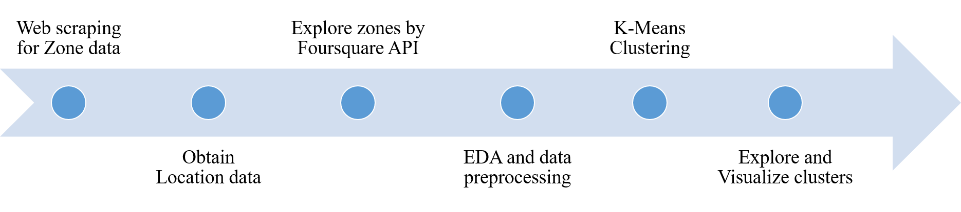
Methodology
Data Extraction and clustering process
Zonal information extracted from webpage
Obtain location information
Explore zones using Foursquare API
EDA and clustering
Explore and visualize cluster

Slide 6
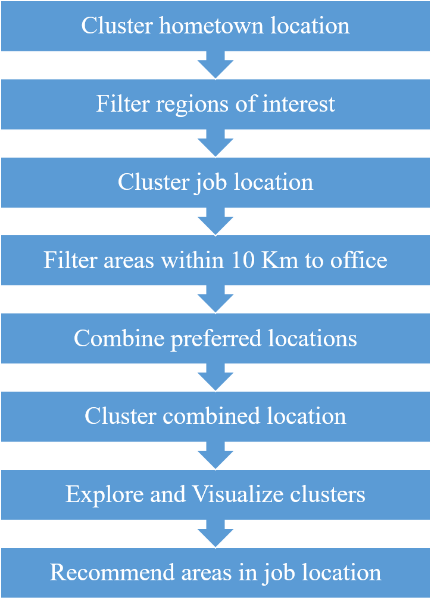
Methodology
Identifying similar neighborhood
Repeat the extraction process for job and home location.
Filter and group important locations
Cluster grouped data
Analyze and recommend similar areas.

Slide 7
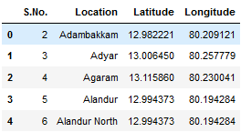
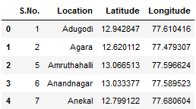
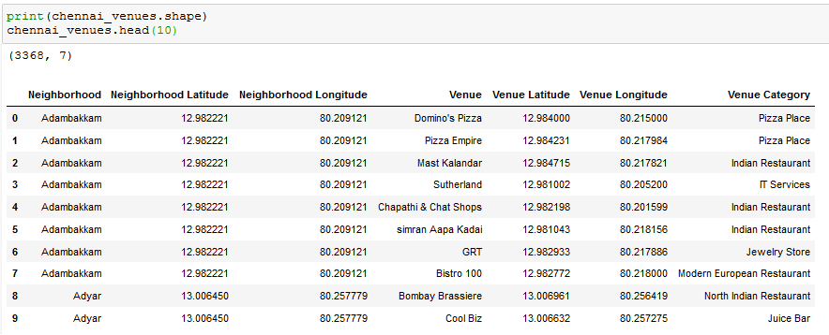
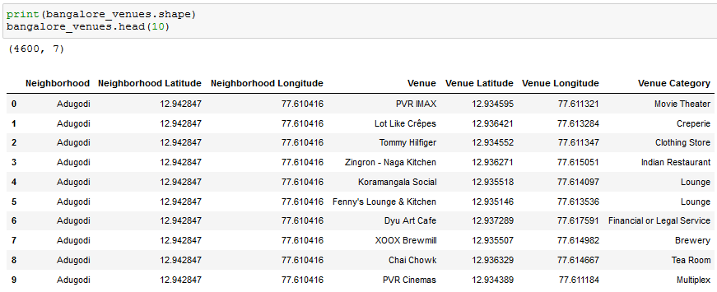
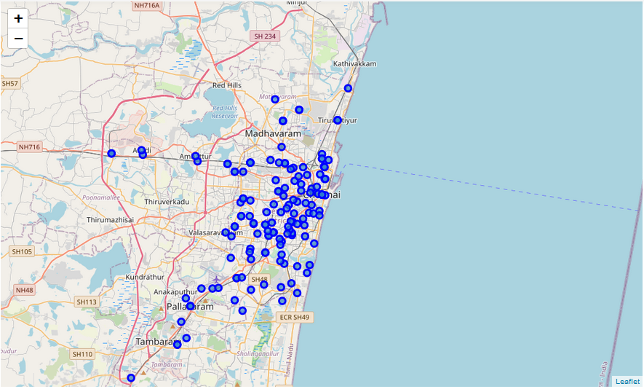
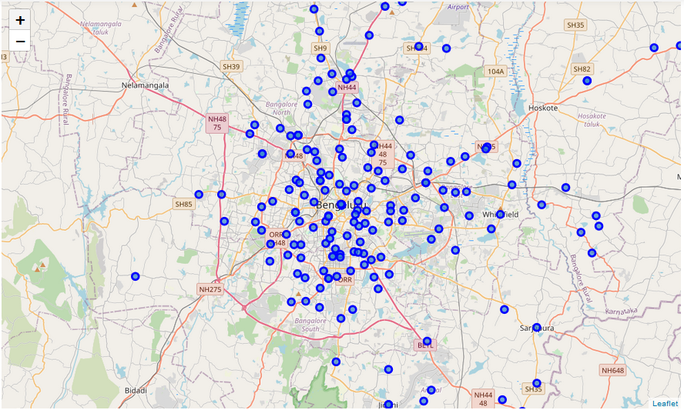
Exploratory data analysis
Home location
Job location

Slide 8
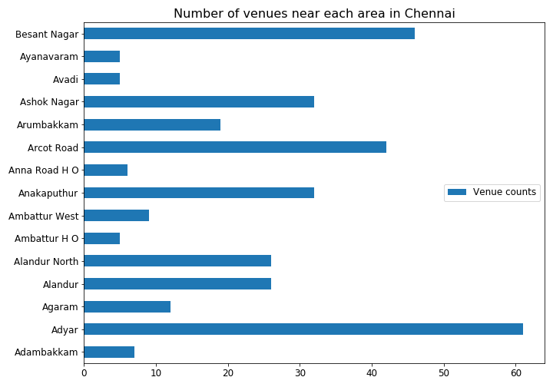
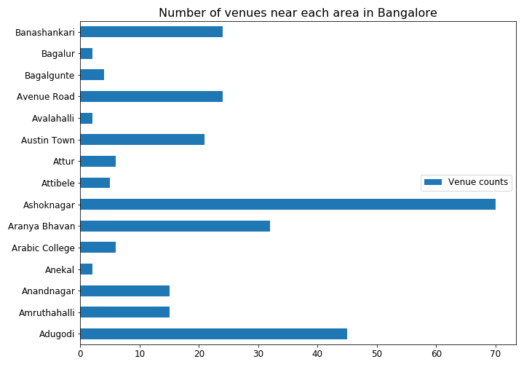
Exploratory data analysis
Home location
Job location

Slide 9
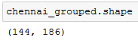
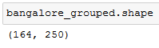
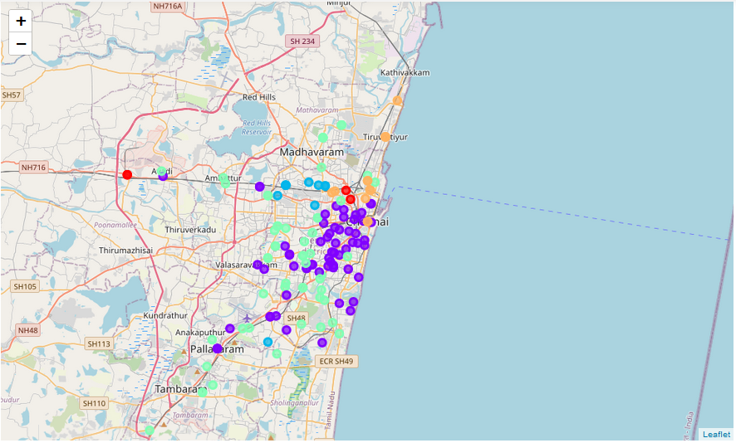
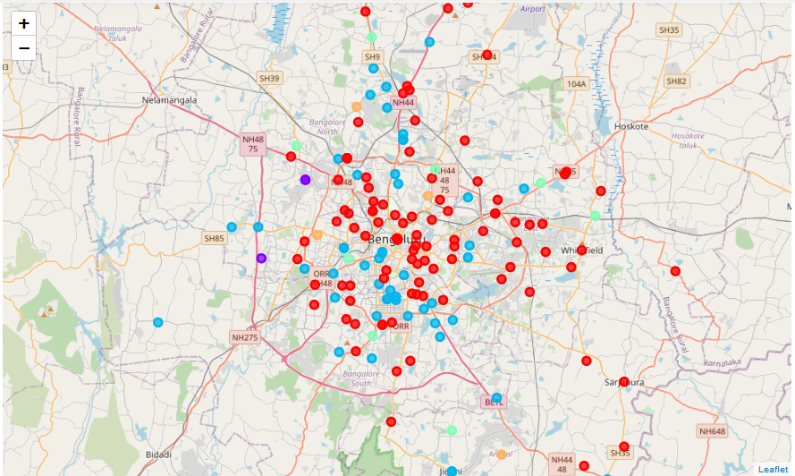
Results
Home location cluster
Job location cluster

Slide 10
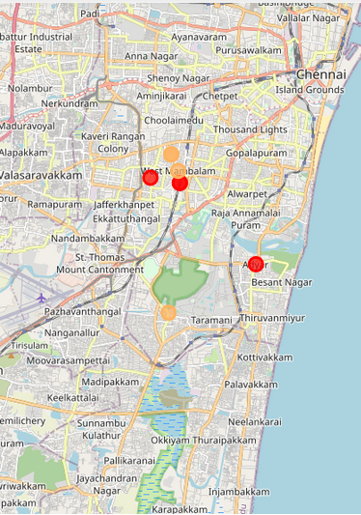
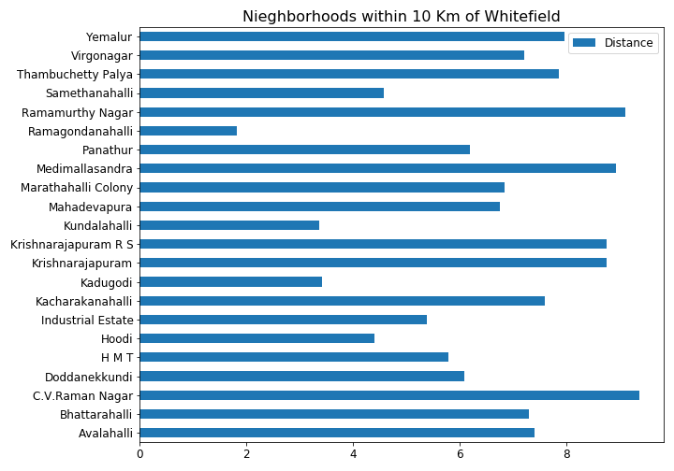
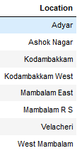
Results
Home location – filtered areas
Job location – filtered areas

Slide 11
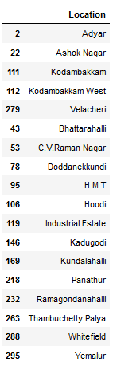
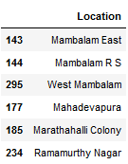
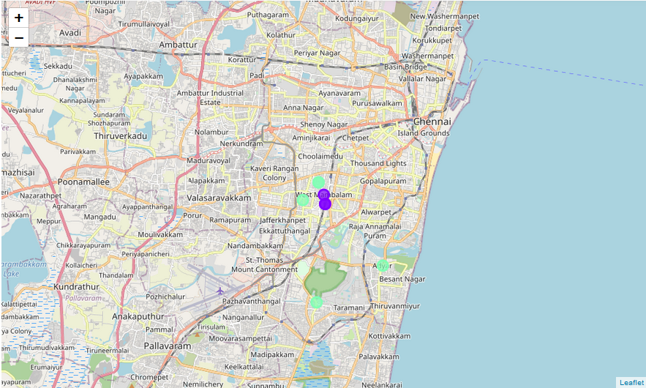
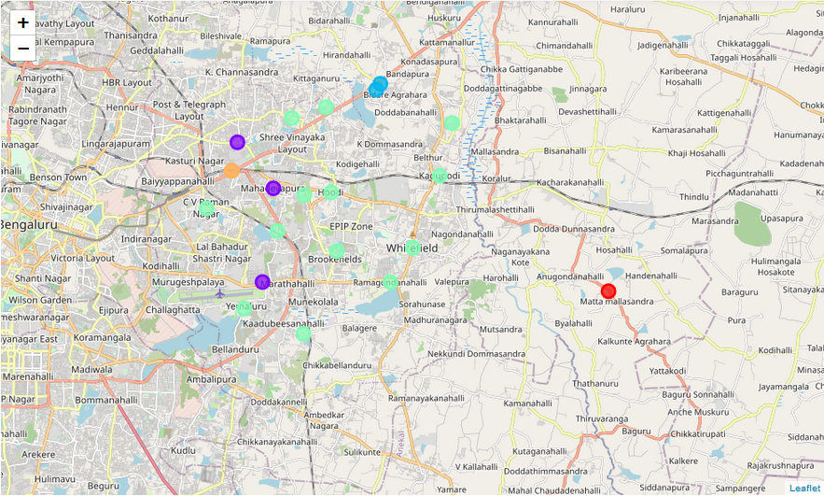
Results
Cluster 2
Important location cluster
Cluster 0
Home location
Job location
All the important home locations are grouped into clusters 0 and 2

Slide 12
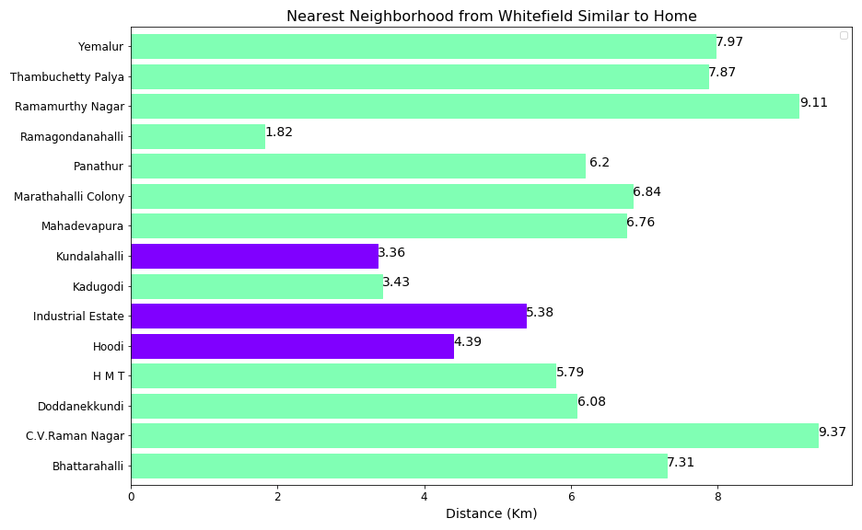
Discussion
Recommend the first two closest locations in each cluster.
Job locations similar to home are
Ramgondanhalli
Kundalahalli
Kadugodi
Hoodi
All locations are less than 5 Km from office.
Job location similar to home.

Slide 13
Conclusion
Recommendation of job areas similar to hometown areas is discussed.
In this preliminary work focus is restricted to identify similar locations.
More features can be included in future for robust results such as
Housing prices
Transportation facilities nearby
Weather etc.

